Slide 1



DIASPOCARE Vulnerability MANAGEMENT

Slide 2


Vulnerability Management
Team Members
Marius
Stella
Hamdiya
Danny
Ola
Jessie
Kate
Greg
Osen
Ishmael

Slide 3


Kick-off Meeting
Kick-off Meeting (with IT and Security Manager)
Security Team and System Owners (Sys Admin, DevOps, Devs, DBAs, GRC, etc…)
Reviewing Pentest and vulnerabilities scan reports
Scope (All assets)
Risk-based Prioritization
High —-> Medium Severity
CVSS 2,3 scores
External —--> Internal vulnerabilities (Internet-facing (external) vulnerabilities should generally be remediated before internal)
Remediation Timeframe
Asset Criticality
Exploit Availability
Assigning responsibilities and roles
Risk Appetite ($15.000)
Creating a POA&M
Vulnerabilities reporting on the POA&M
Vulnerabilities remediation planning and Milestones

Slide 4

Follow-up Meeting (Budget)
1. Financial Cost Overview
Estimated Budget: $15,000
Breakdown:
Personnel/Consultants: $6,000
Tools & Technology: $4,000
Training & Awareness: $2,500
Contingency & Miscellaneous: $2,500
2. Expenses Timeline
Q3 2025 (July–Sept):
Initiate vendor onboarding
Begin implementation: $9,000 total
Tools procurement
Initial training sessions
Early consultant engagement
Q4 2025 (Oct–Dec):
Full rollout and assessment: $6,000 total
Program optimization
Compliance and reporting
Continued training and maintenance
3. Risk Appetite & Tolerance
Defined Tolerance: Financial exposure up to $15,000
Risk Appetite Statement: "We are willing to accept moderate financial risk within the $15,000 ceiling to ensure critical operational security improvements and stakeholder compliance are achieved."

Slide 5

External Vulnerabilities
Higher exposure risk: External-facing systems (e.g., web servers, VPNs, email gateways) are accessible to attackers from anywhere in the world.
Immediate threat vector: These are the entry points for most cyberattacks, including ransomware, phishing, and DDoS.
Compliance pressure: Many regulations (e.g., PCI DSS, HIPAA) emphasize securing public-facing assets.
Three Key Reasons
Highest Exposure Risk
Attackers worldwide can probe these systems 24/7
﻿﻿Primary Attack Vector
﻿﻿Most hacks (ransomware, phishing, DDoS) start here
﻿﻿Regulatory Spotlight
﻿﻿Rules like PCI-DSS and HIPAA mandate strong public-facing security

Slide 6
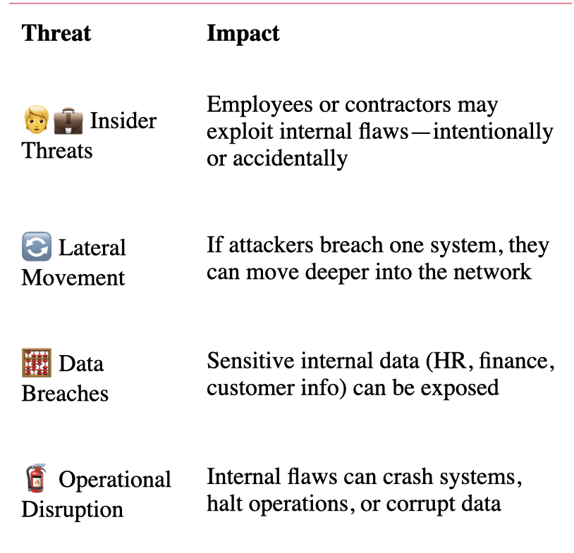
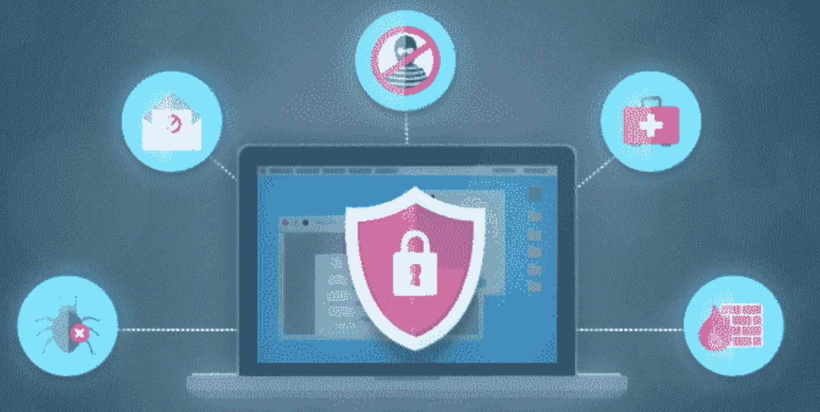
Internal Vulnerabilities
﻿﻿Security weaknesses that exist inside your private network
﻿﻿Hidden Risk: Not visible on the internet, but still exploitable
﻿﻿"Behind the Firewall": Often overlooked because they're assumed safe

Slide 7

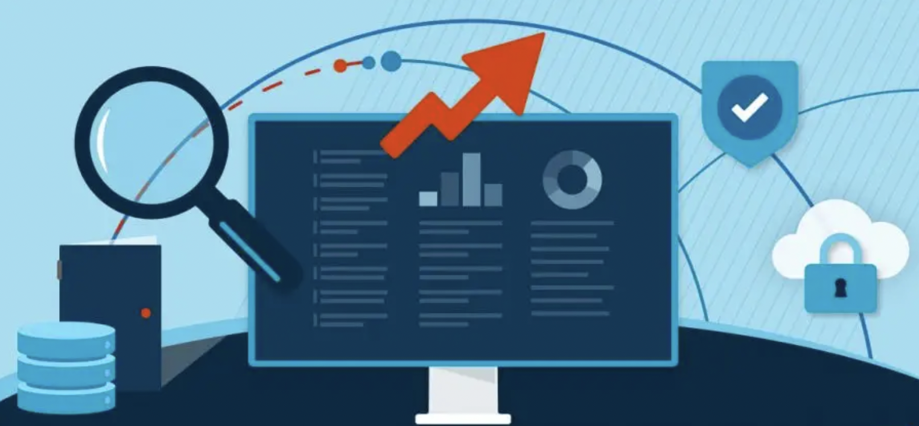

Recommendations for DiasporaCare
Start with External Scans
Scan all internet-facing assets (web portals, VPNs, email gateways) to identify and fix high-risk exposures first.
Follow with Internal Scans
Assess private network systems -employee devices, servers, file shares - to harden defenses and spot lateral-movement pathways.
Adopt a Continuous, Risk-Based Cycle
Detect: Run external scans, prioritize by CVSS score, exploit availability & business impact
Remediate: Patch or reconfigure during maintenance windows
Repeat: Perform internal scans focusing on critical assets, then loop back for ongoing coverage

Slide 8

Follow-up Meeting (strategies)
Definitions with examples from POA&M
Remediation plans: A concise, structured outline of actions to eliminate a discovered vulnerability.
E.g., for a TLS Version 1.0 Protocol Detection, the remediation plan is “to disable TLS 1.0, enable TLS 1.2 and TLS 1.3, and verify that all endpoints support these secure versions”.
Planned Milestones: A succinct checkpoint marking the completion of a key remediation phase to track and measure progress toward resolving a vulnerability.
E.g., for the vulnerability in slide 1/85, SSL Certificate Cannot Be Trusted, the planned milestone for remediation is “Phase 1: Certificate decision made, Phase 2: Certificate Obtained, Phase 3: Certificate Tested”
Milestone Due Date: The specific date on which a planned milestone must be achieved to keep remediation efforts on schedule,
E.g., for the vulnerability in slide 18/929 HTTP TRACE/TRACK METHODS ALLOWED, for the two-weeks remediation starting on 08/06/25, the milestone due date is 08/20/25.

Slide 9
Follow-up Meeting (strategies) Continued
Remediation/ System owners: Individuals roles responsible for the procurement, development, integration, operation, maintenance, and eventual disposal of an information system.
E.g., system administrator/ IT security team for vulnerability as seen in slide 18/929.
Resources: The personnel, tools, funding, technologies, and environments required to effectively plan, test, and remediate identified vulnerabilities.
E.g., slide 13/929, HSTS Missing from HTTPS Server (RFC 6797), some of the resources required for remediation are Server access, vulnerability scan results, inventory list, browser console tests, HTTPS enforcement analysis, compatibility tools etc.
Monitoring: The continuous observation of systems, networks, and applications to detect, alert on, and respond to security threats as they arise.
E.g., for the vulnerability slide 19/929 SSL Certificate Expiry, Original Severity: High, Adjusted Severity: Medium. By renewing all expiring certificates, validating their deployments, and enabling automated expiry alerts, the risk of service disruption due to certificate lapses is reduced one notch from High to Medium.

Slide 10


Remediation Actions
Patching: Apply vendor patches or updates.
Configuration Change: Modify system configurations or disable vulnerable services.
Mitigation: Apply compensating controls (e.g., WAF rules) if patching is not immediately possible.
Removal: Decommission or replace vulnerable systems/components.

Slide 11


Verification and Validation
Re-scan within 24–72 hours after remediation to confirm closure.
QA team or vulnerability management team signs off on resolution.
Update asset inventory and configuration management database (CMDB).
Update Change Management Documents

Slide 12

Exceptions Process
Submit exception request including:
Business justification
Risk acceptance statement
Proposed compensating controls
Duration of the exception
Review and approval by CISO or Risk Committee.
All exceptions documented and reviewed quarterly

Slide 13


Metrics and Reporting
Number of open vulnerabilities by severity
Mean Time to Remediate (MTTR)
Compliance with SLAs
Aging vulnerabilities report
Top 10 vulnerable assets
Reports delivered weekly to IT management, monthly to senior leadership.

Slide 14
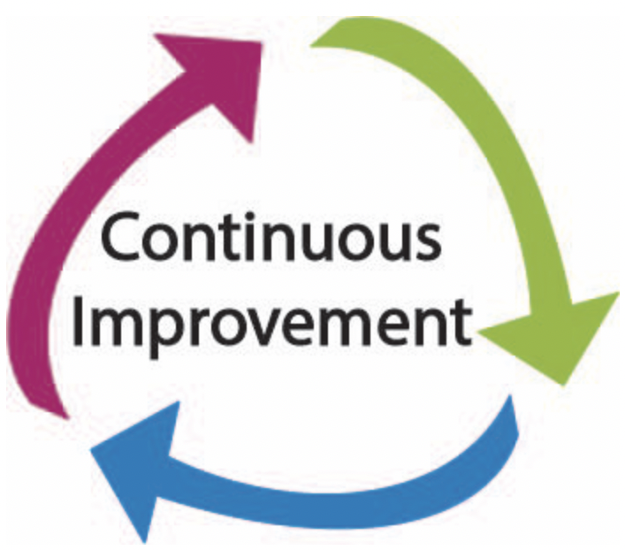
Continuous Improvement
Quarterly process reviews
Incorporate lessons learned from incidents and audits
Stay aligned with latest threat trends and technologies

Slide 15
Findings,Training & Awareness, Change MNGMT
Findings:
SSL Certificate Mismatch: CN does not align with hostnames, risking trust and encryption integrity.
Splunk Dashboard Exposure: Drilldown components may leak user data when shared improperly.
Patch Management Gaps: Delays in applying vendor updates increase exposure windows.
Access Control Weaknesses: Over-permissioned users and lack of RBAC enforcement.
Monitoring Deficiencies: Limited visibility into dashboard sharing and user behavior
Training Deploy targeted role-based training modules covering:
Secure dashboard creation and sharing
Data handling best practices
Incident escalation procedures
Compliance responsibilities for HIPAA and internal policy
CM Recommendations : (change management policy update)
Require formal approval and rollback plans for all dashboard and system changes
Maintain version control and audit logs for Splunk and other critical platforms
Integrate change documentation with incident response and compliance workflows

Slide 16

QAs and Concerns
Analysis excel document: What is the meaning of the rows at the very bottom?
Why there is no “unique vulnerability identifier” in the reports?
Difficulty to search by the vulnerability name on (NVD, CVE, CWE, MITRE-ATTACKS, FIRST(CVSS))
Vulnerabilities not having
CVSS 2, 3
Available exploitation (TRUE/FALSE)
Severity
Publication date
No data at all

